Slide 1






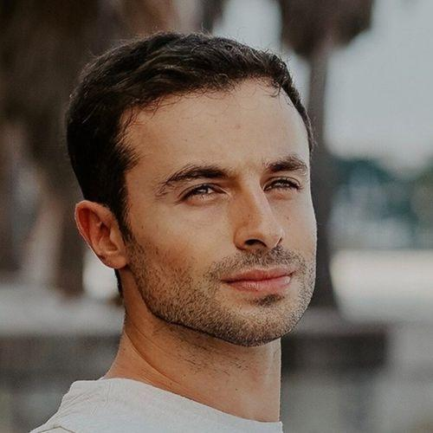


WORKSHOPS
Multimodal App Building with DALLE 3 & GPT-4-V
Paul Quigley
Insert headshot
Founder
Zero Shots Labs

Slide 2



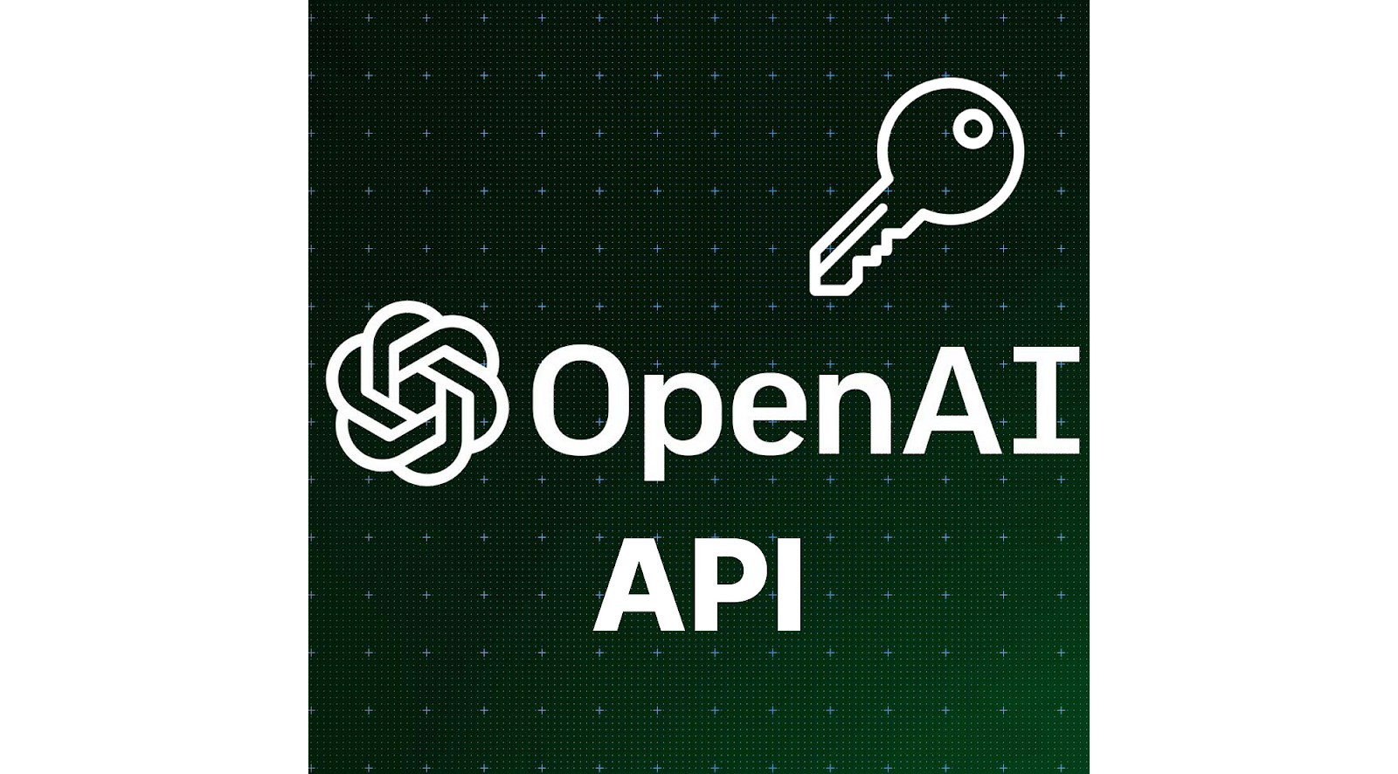
Workshop Prerequisites
Required:
OpenAI API Key
Basic familiarity with Python and Google Colab
Basic familiarity with prompting/Large Language Models (LLMs)

Slide 3

About The Instructor
Paul
Zero Shot Labs (ZSL):
Stanford Computer Science + AI Lab
Palantir / Addepar (Top-VC backed data analytics companies)
5 years as a VC investing in AI
Now runs ZSL
AI instruction and training seminars (like this one)
Advising on AI strategy
Implementing AI solutions
Projects led by PhD-level talent
Contact: pquigley@zeroshotlabs.com

Slide 4
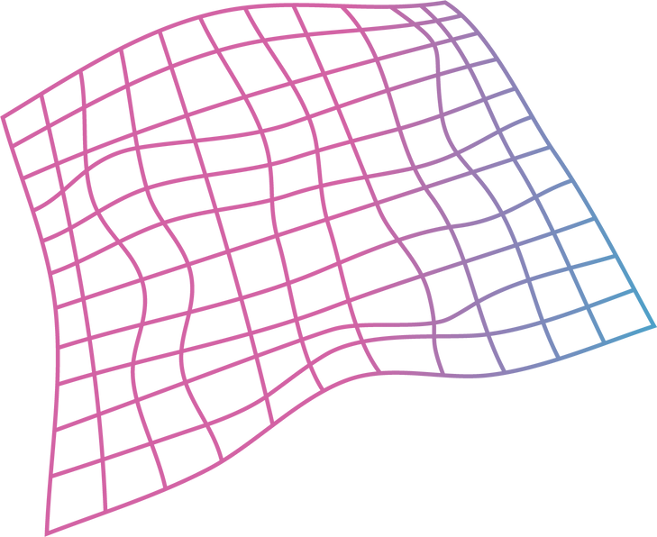
Agenda
1
Tech Overview
20 Minutes
2
Hands-on Practice
20 Minutes
3
Demos
Follow Along
4
Final Quiz
6 Questions
5
Q & A

Slide 5


Tech Overview

Slide 6

Problem:
Creating an AI assistant for frontend developers
You are creating an AI assistant for frontend developers. Users verbally describe a component/page that they would like built and the AI generates code to create that component.
However, users are complaining that it is too difficult to describe the frontend components in excruciating detail.

Slide 7

Solution:
Multimodal Models
What if instead, we simply let the user upload a picture of the component they want to build, and generated the code from there?
This would be great, but we’d need a model that could understand images rather than just text.

Slide 8
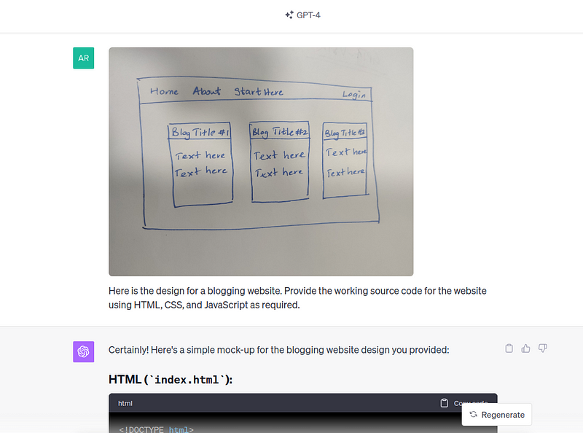
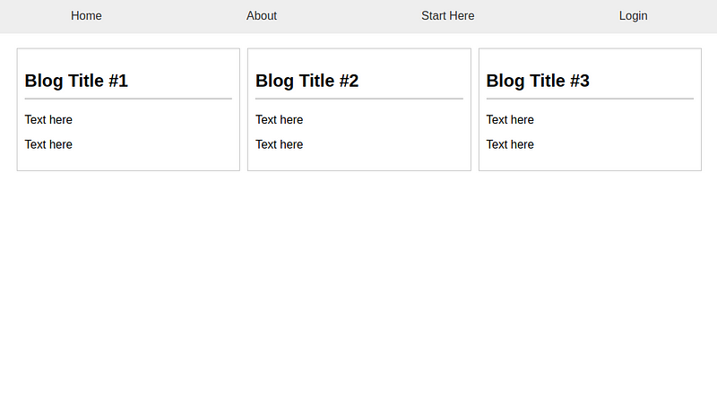
Solution Cont.
In fact GPT-4-Vision has been used for frontend code generation like what we described
Source: DataCamp

Slide 9
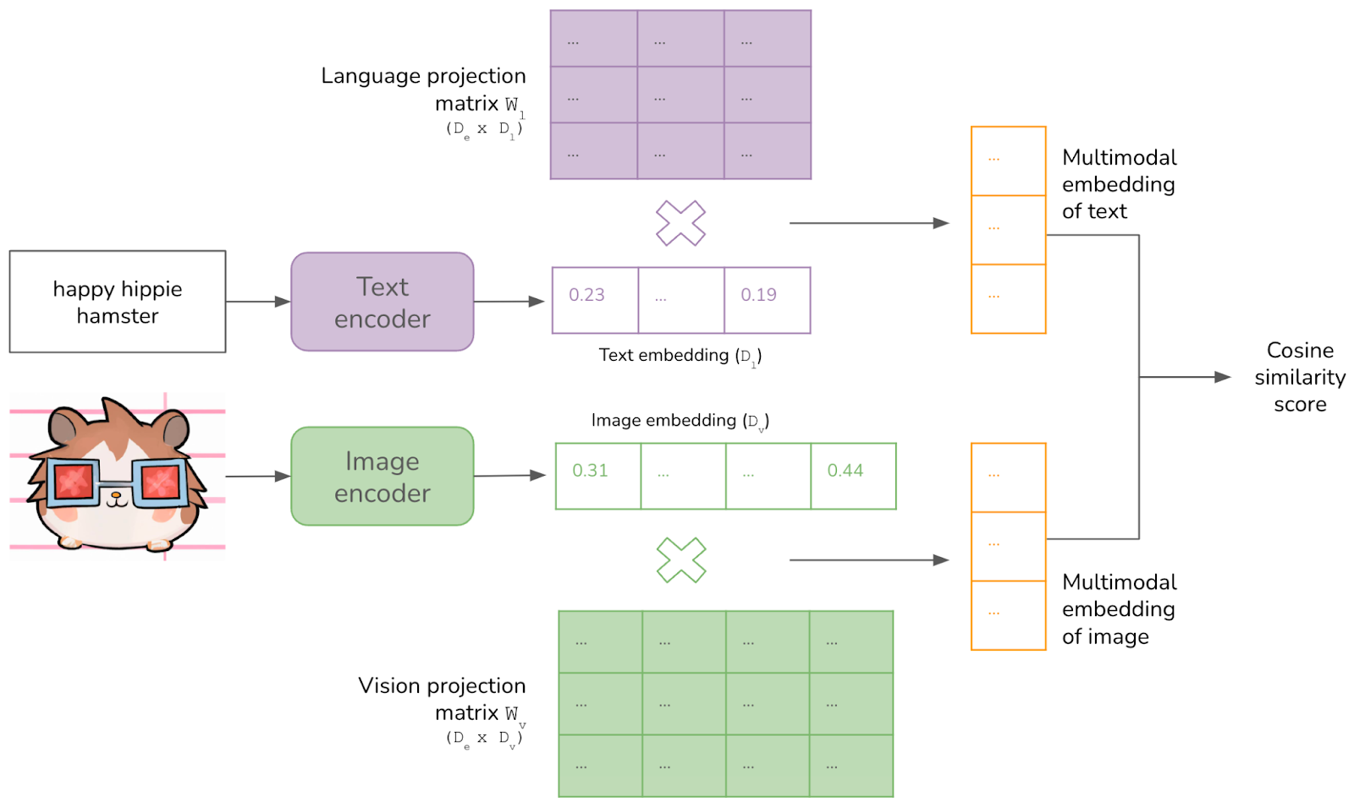
How do multimodels even work?
Need to have a shared numerical representation of both images and text
Source: Chip Huyen’s Blog

Slide 10
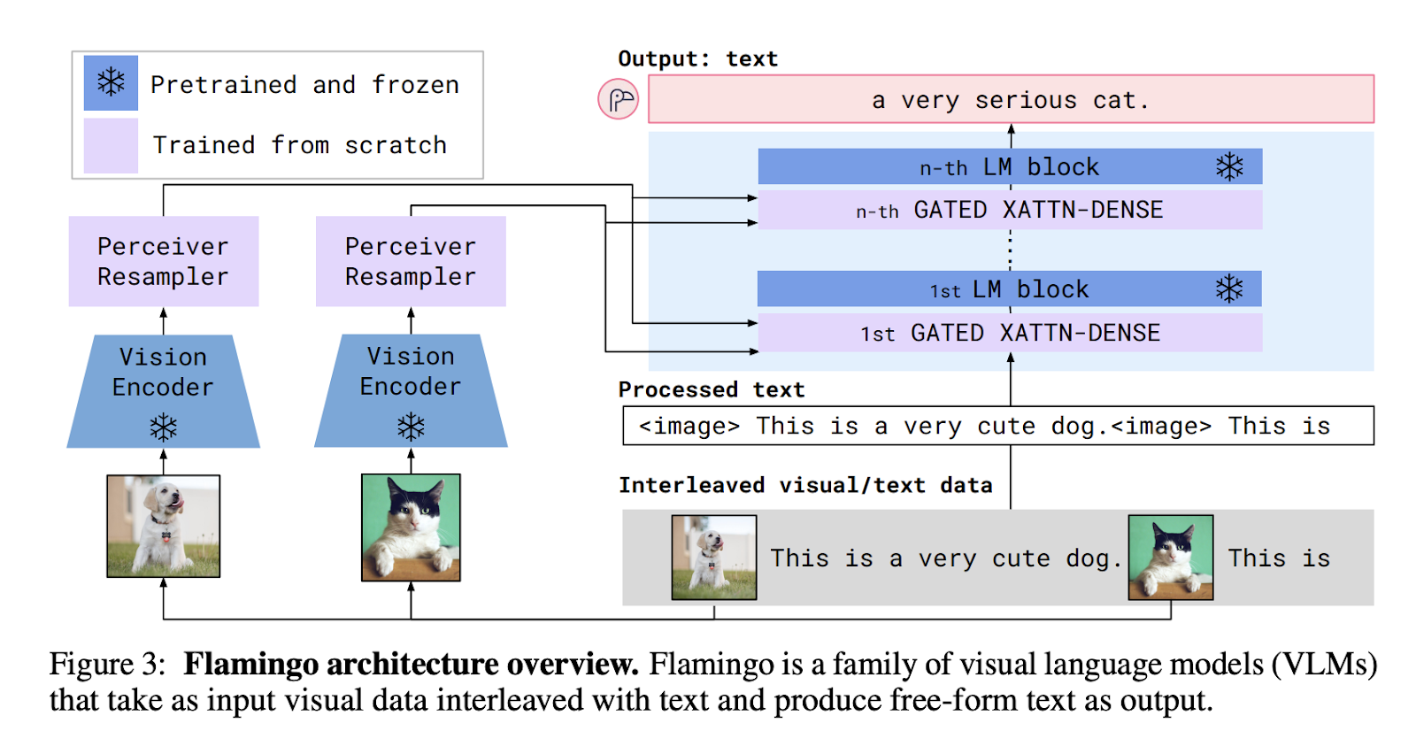
Combine the image and text encodings to answer queries
Source: Flamingo Paper

Slide 11
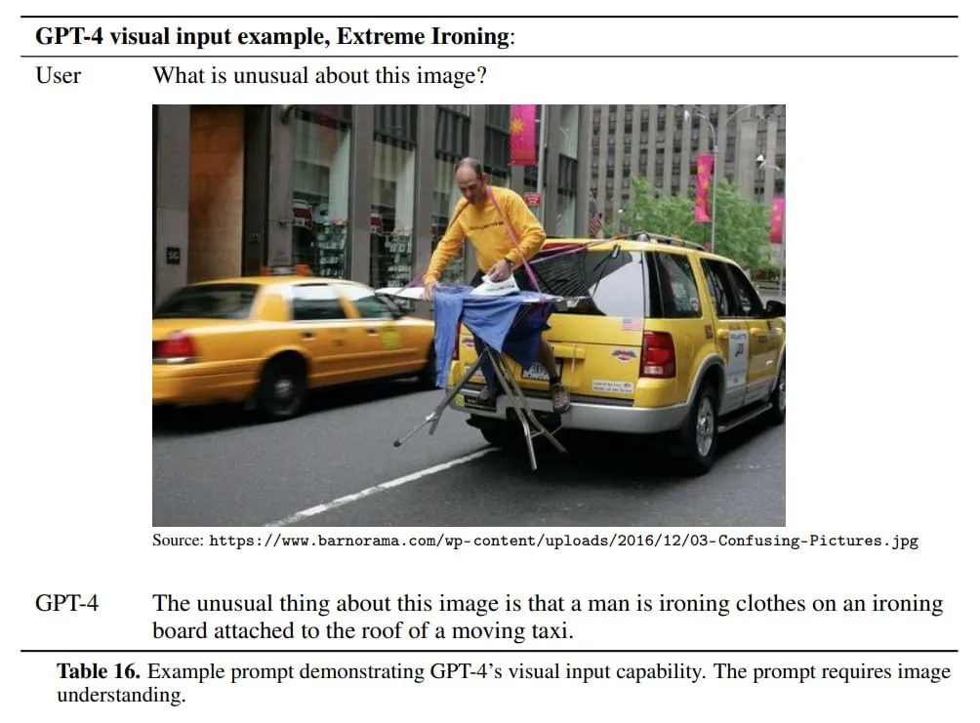
The multimodal model that we will use today:
GPT-4-V

Slide 12
Demo
Follow along here:
http://tinyurl.com/ZSL-multimodal-models

Slide 13
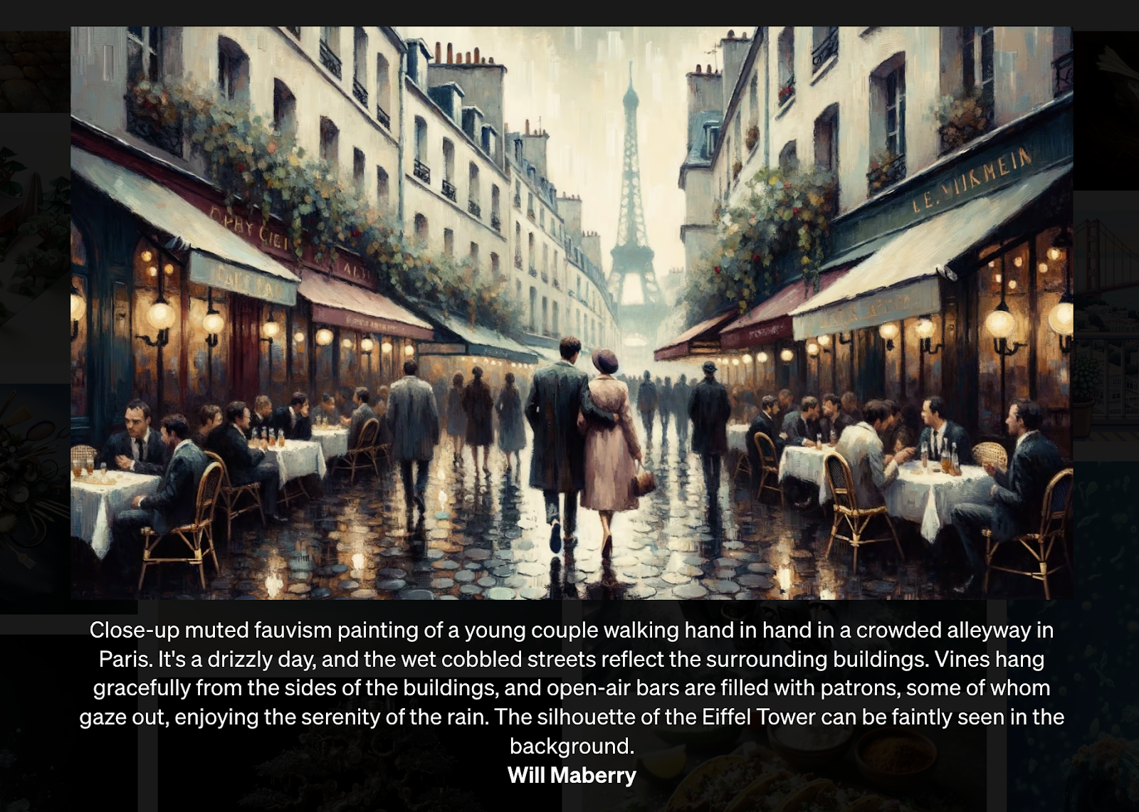
Shifting Gears: DALL·E 3
OpenAI’s advanced model for creating photorealistic images
Source: OpenAI cookbook

Slide 14
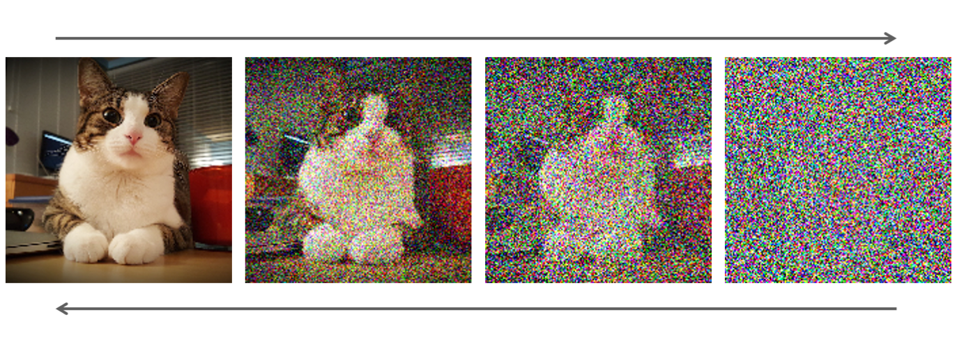
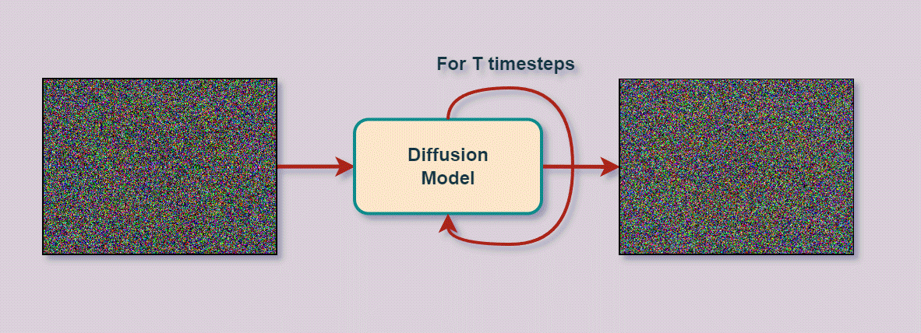
How do these text to image models work?
Diffusion Model

Slide 15
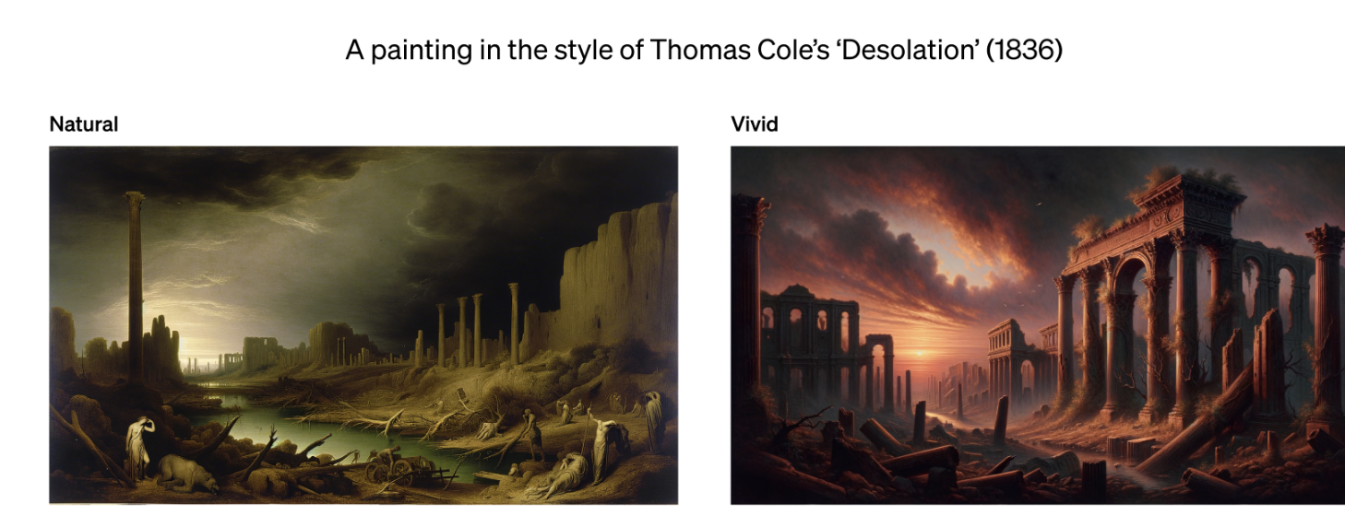
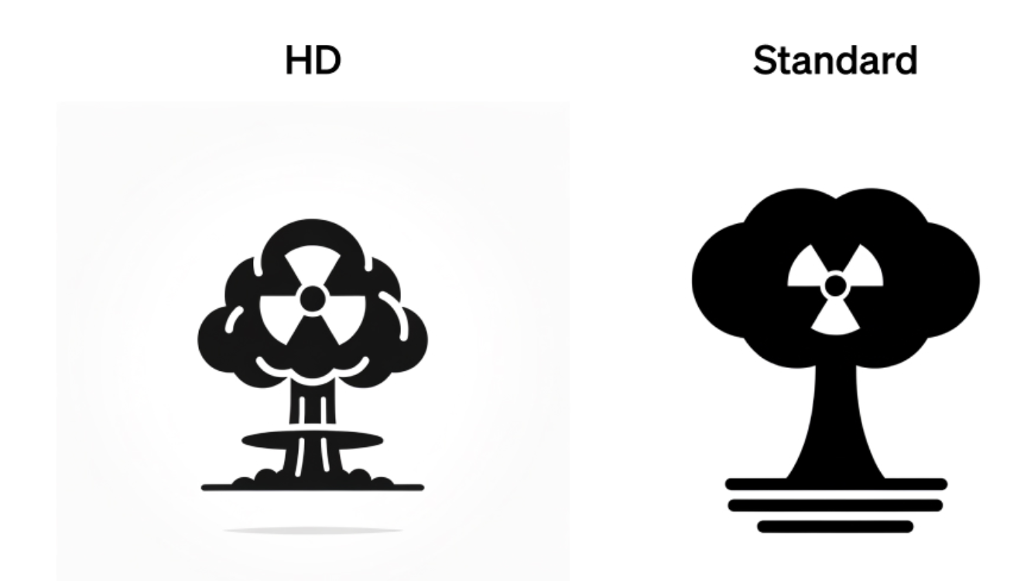
Key DALL·E 3 Parameters
1. Style (“natural” or “vivid”)
(default) “vivid” for more realistic images
“natural” for more cartoonish looking images
2. Quality (“standard” or “hd”)
Insert Image Here
(default) “standard” for less detailed images
“hd” for images with ultra fine-grained details
3. Size
Must be one of 1024x1024, 1792x1024, or 1024x1792 for DALL·E-3

Slide 16
Advice on Prompting DALL·E 3
Be specific!
Know the model’s weaknesses
e.g., not great with long strings of text
Exciting results when you combine it with GPT models
e.g., we’re working with an edtech company where we generate exercises for students. That much more engaging when we combine with generated images.
Be mindful of copyright/content restrictions

Slide 17
Demo
Follow along here:
http://tinyurl.com/ZSL-multimodal-models

Slide 18
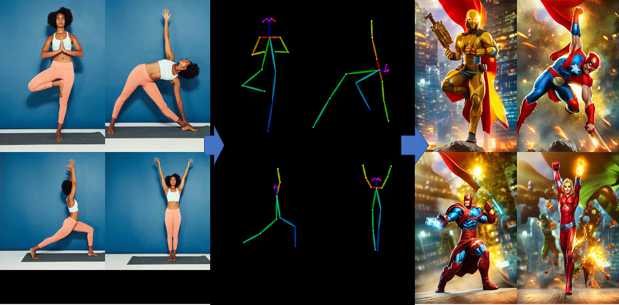
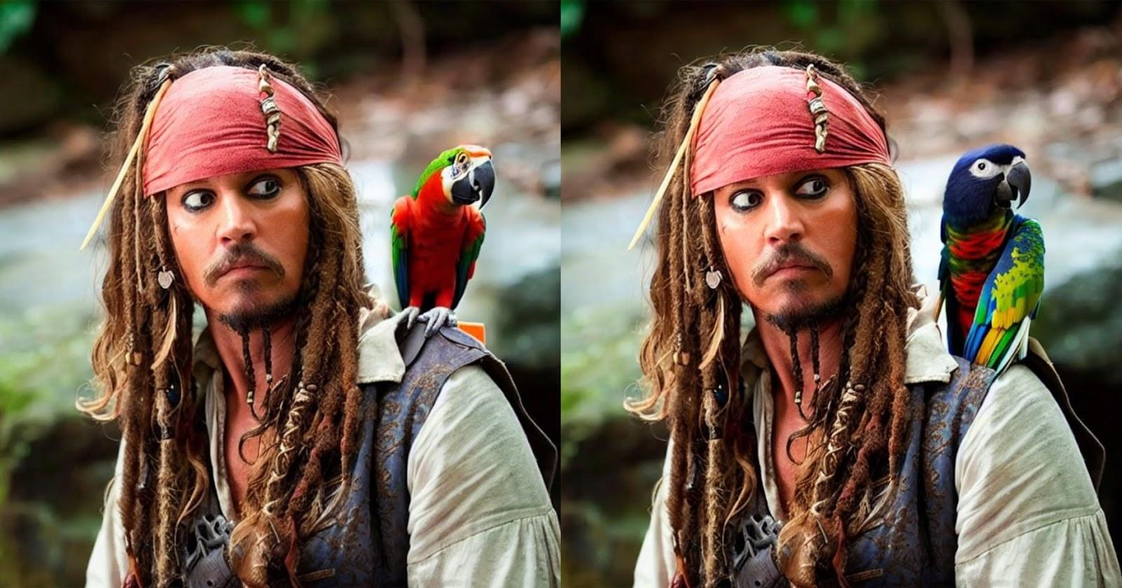
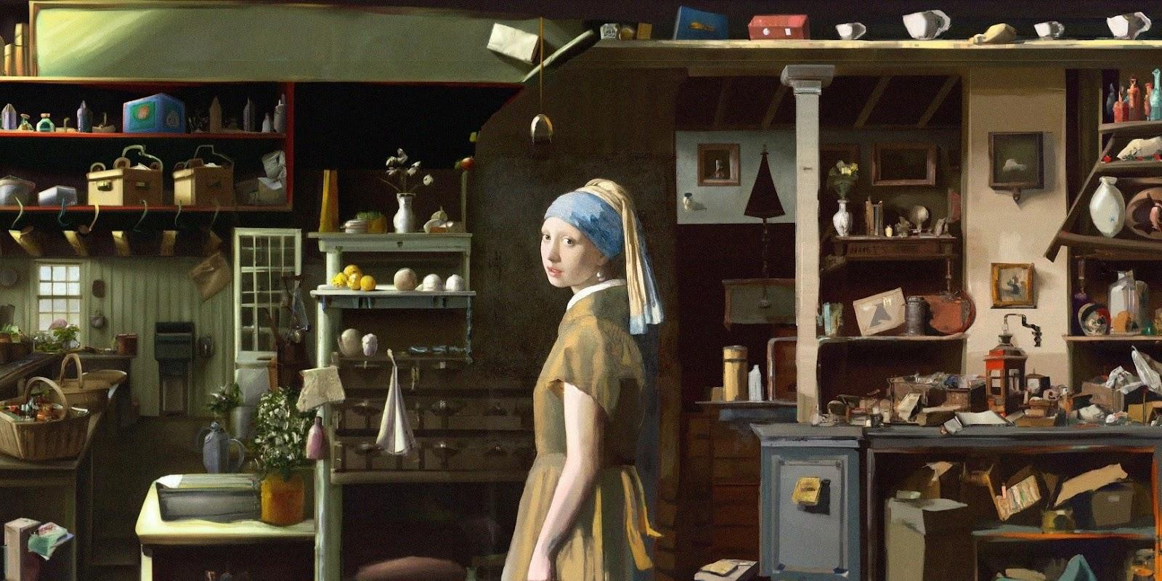
Text to Image Models
Other interesting capabilities of text to image models:
ControlNets
Inpainting
Outpainting

Slide 19
Hands-On Exercise

Slide 20
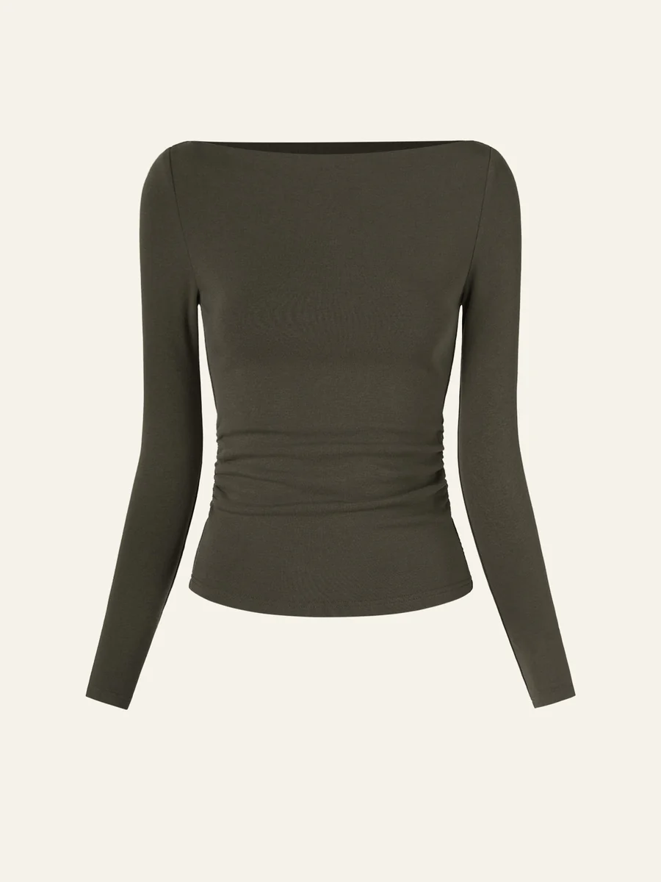
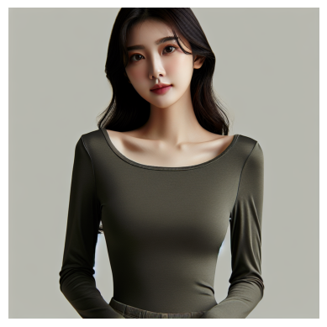
Application for apparel e-commerce company to generate images

Slide 21
Go to the last cell in this Google Colab and copy the Colab to your drive to begin filling in your solution:
http://tinyurl.com/ZSL-multimodal-models

Slide 22
Final Quiz

Slide 23
Question 1
Which of the following is NOT a valid parameter for DALL E3?
A. Style
B. Expressiveness
C. Quality

Slide 24
Question 1
Which of the following is NOT a valid parameter for DALL E3?
A. Style
B. Expressiveness
C. Quality

Slide 25
Question 2
Which of the following is the name of a transformer used to incorporate image encodings into text encodings when using models?
A. Perceiver Resampler
B. Diffuser
C. Encoder

Slide 26
Question 2
Which of the following is the name of a transformer used to incorporate image encodings into text encodings when using models?
A. Perceiver Resampler
B. Diffuser
C. Encoder

Slide 27
Question 3
What is the name of the type of model used to generate images in text-to-image models like DALL-E 3?
A. Convolutional
B. Diffusion
C. Encoder

Slide 28
Question 3
What is the name of the type of model used to generate images in text-to-image models like DALL-E 3?
A. Convolutional
B. Diffusion
C. Encoder

Slide 29
Question 4
Which of the following is the name of an early multimodal model that provided text completion from image + text inputs?
A. Flamingo
B. Kestrel
C. Seagull

Slide 30
Question 4
Which of the following is the name of an early multimodal model that provided text completion from image + text inputs?
A. Flamingo
B. Kestrel
C. Seagull

Slide 31
Question 5
Which of the following is a weakness of the DALL-E-3 models text generation capabilities?
A. Bad at generating realistic human faces
B. Bad at generating long strings of text
C. Bad at generating the sun in the sky

Slide 32
Question 5
Which of the following is a weakness of the DALL-E-3 models text generation capabilities?
A. Bad at generating realistic human faces
B. Bad at generating long strings of text
C. Bad at generating the sun in the sky

Slide 33
Question 6
Which of is a type of text-to-image model that gives the user some ability to guide the shape/form of the produced image?
A. Bad at generating realistic human faces
B. Bad at generating long strings of text
C. ControlNets

Slide 34
Question 6
Which of is a type of text-to-image model that gives the user some ability to guide the shape/form of the produced image?
A. Bad at generating realistic human faces
B. Bad at generating long strings of text
C. ControlNets

Slide 35
Q&A

Slide 36
Thank You!
pquigley@zeroshotlabs.com

